Slide 1
Master Student Guidelines

Slide 2
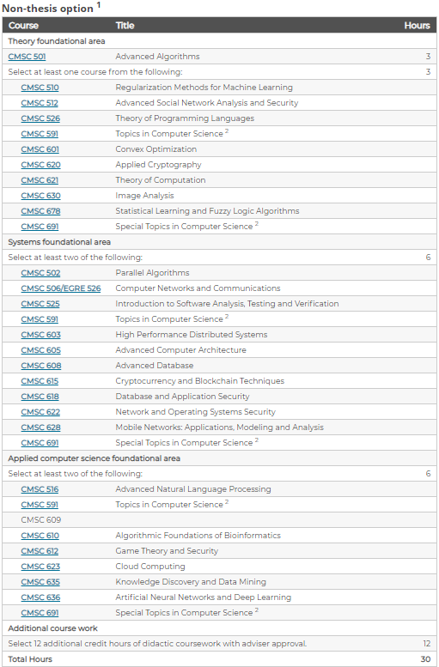
MS Requirements
Non-thesis option
  30 credits (10 courses)
Thesis option
  21 credits (7 courses)
  9 credits of Directed Research
  You will need to write and defend a Thesis based on your research results
  Your advisor will form an advisory committee in which you will defend
Courses are divided into three Foundational Areas
  Theory
  Systems
  Applied
>= 50 of your courses
must be at the 600 level

Slide 3
Thesis MS Requirements
  21 credits (7 courses)
  9 credits of Directed Research
  Complete didactic courses
  Plan of study
  Thesis Committee
  Thesis Defense
>= 50 of your courses
must be at the 600 level

Slide 4
Thesis MS Requirements
  The student’s plan of study constitutes a tentative list of courses that are taken as part of the graduate degree program. A plan of study is dynamic and can be revised as the need arises. The student’s advisor and Advisory Committee must approve the plan of study (form M1 or D1).
  Complete didactic courses
  Plan of study
  Thesis Committee
  Thesis Defense
FORM
https://egr.vcu.edu/academics/student-services/resources-forms/

Slide 5
Thesis MS Requirements
Committee consists of 4 faculty members, including the primary Research Advisor.
  2 committee members must be from the CS graduate program
  1 committee members from outside; whenever possible, one of the committee members should be from outside of VCU.
  Complete didactic courses
  Plan of study
  Thesis Committee
  Thesis Defense
FORM
https://egr.vcu.edu/academics/student-services/resources-forms/

Slide 6
Thesis MS Requirements
Typically, this happens during CS Seminar Fridays at noon
Coordinate with seminar coordinators:
  Dr. Damevski kdamevski@vcu.edu
  Dr. Bulut ebulut@vcu.edu
Ensure to give them a minimum of three months notice
  Complete didactic courses
  Plan of study
  Thesis Committee
  Thesis Defense

Slide 7

Thesis MS Requirements
Fill out forms!!
  Before the defense
    Form: Notice of final defense
    Form: Admission to Candidacy
  After the proposal defense
    Form: ETD Approval Form
  Complete didactic courses
  Plan of study
  Thesis Committee
  Thesis Defense
https://egr.vcu.edu/academics/student-services/resources-forms/

