Slide 1
Instructions for exporting as PDF
Go to File > Export…
Select the file format as PDF
Be sure to select the “Best for printing” option
This will help prevent the PDF from being pixelated and provide the best quality option for printing.

Slide 2
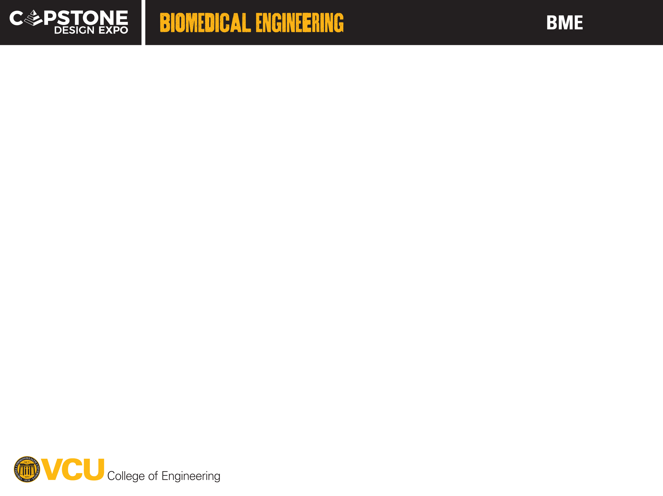
26-101

Slide 3
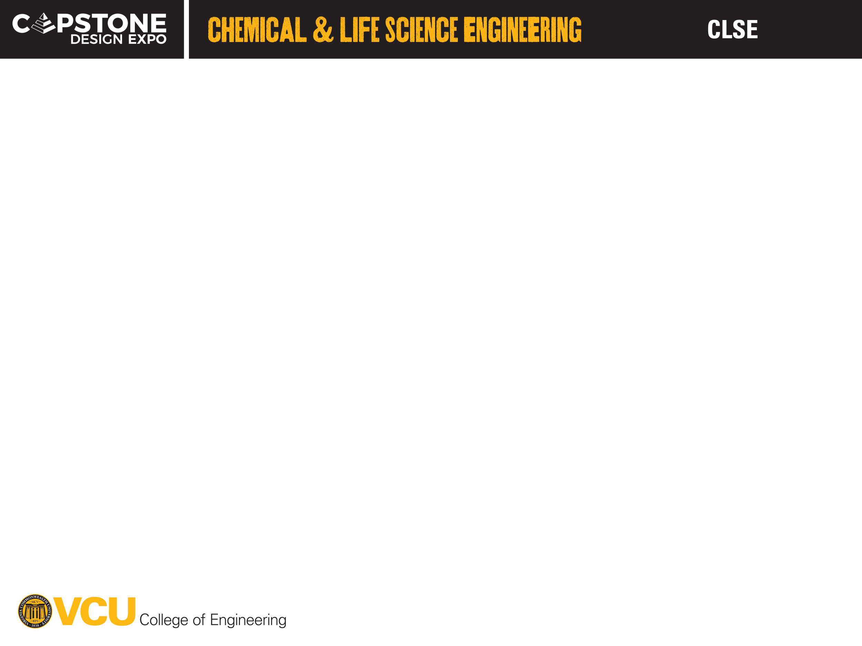
26-101

Slide 4
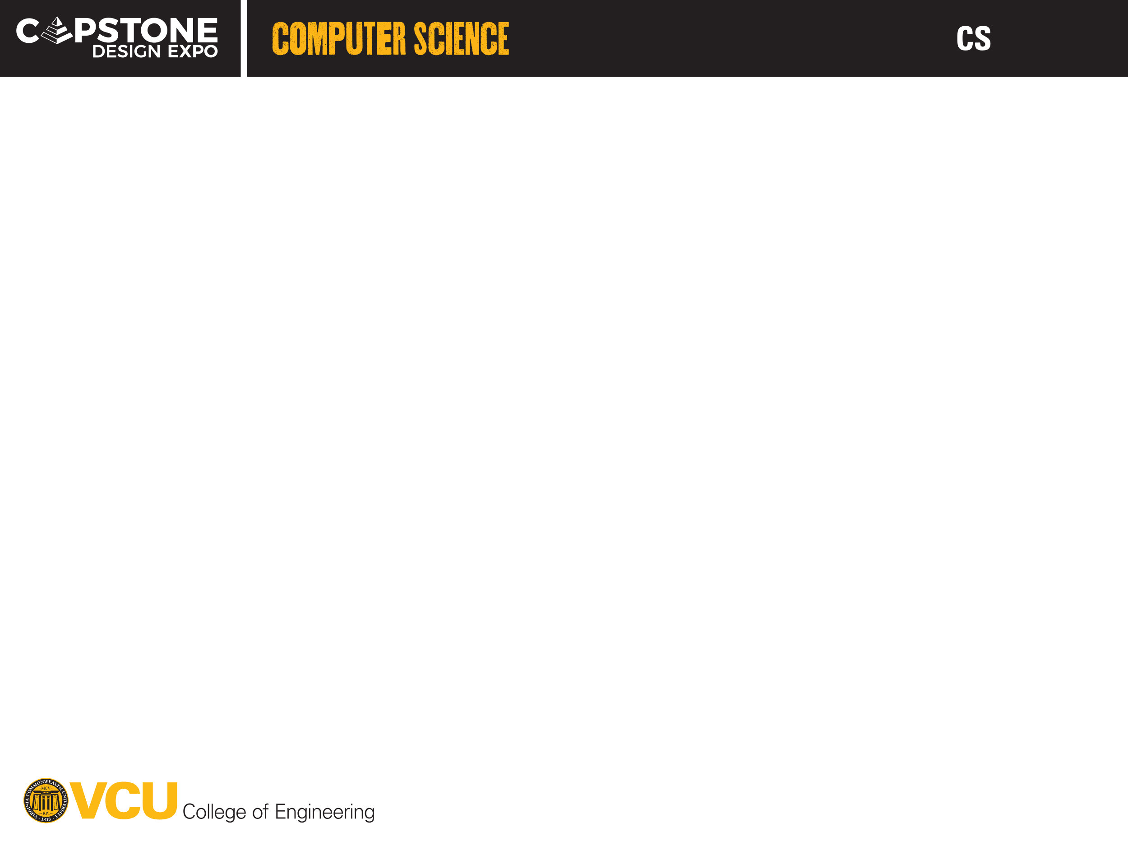
26-101

Slide 5

26-101

Slide 6
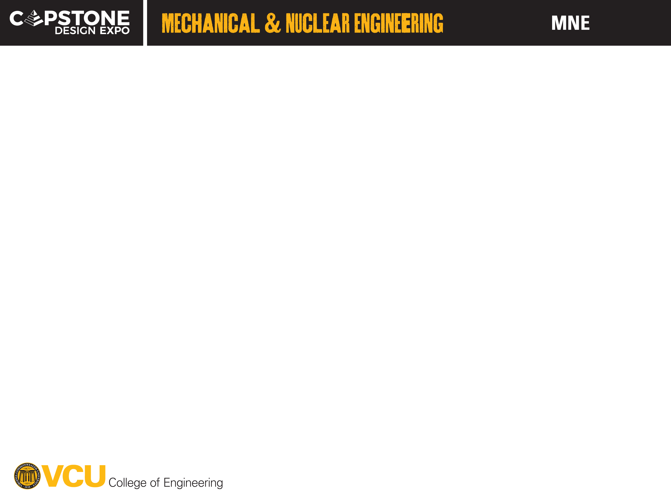
26-101

Slide 7
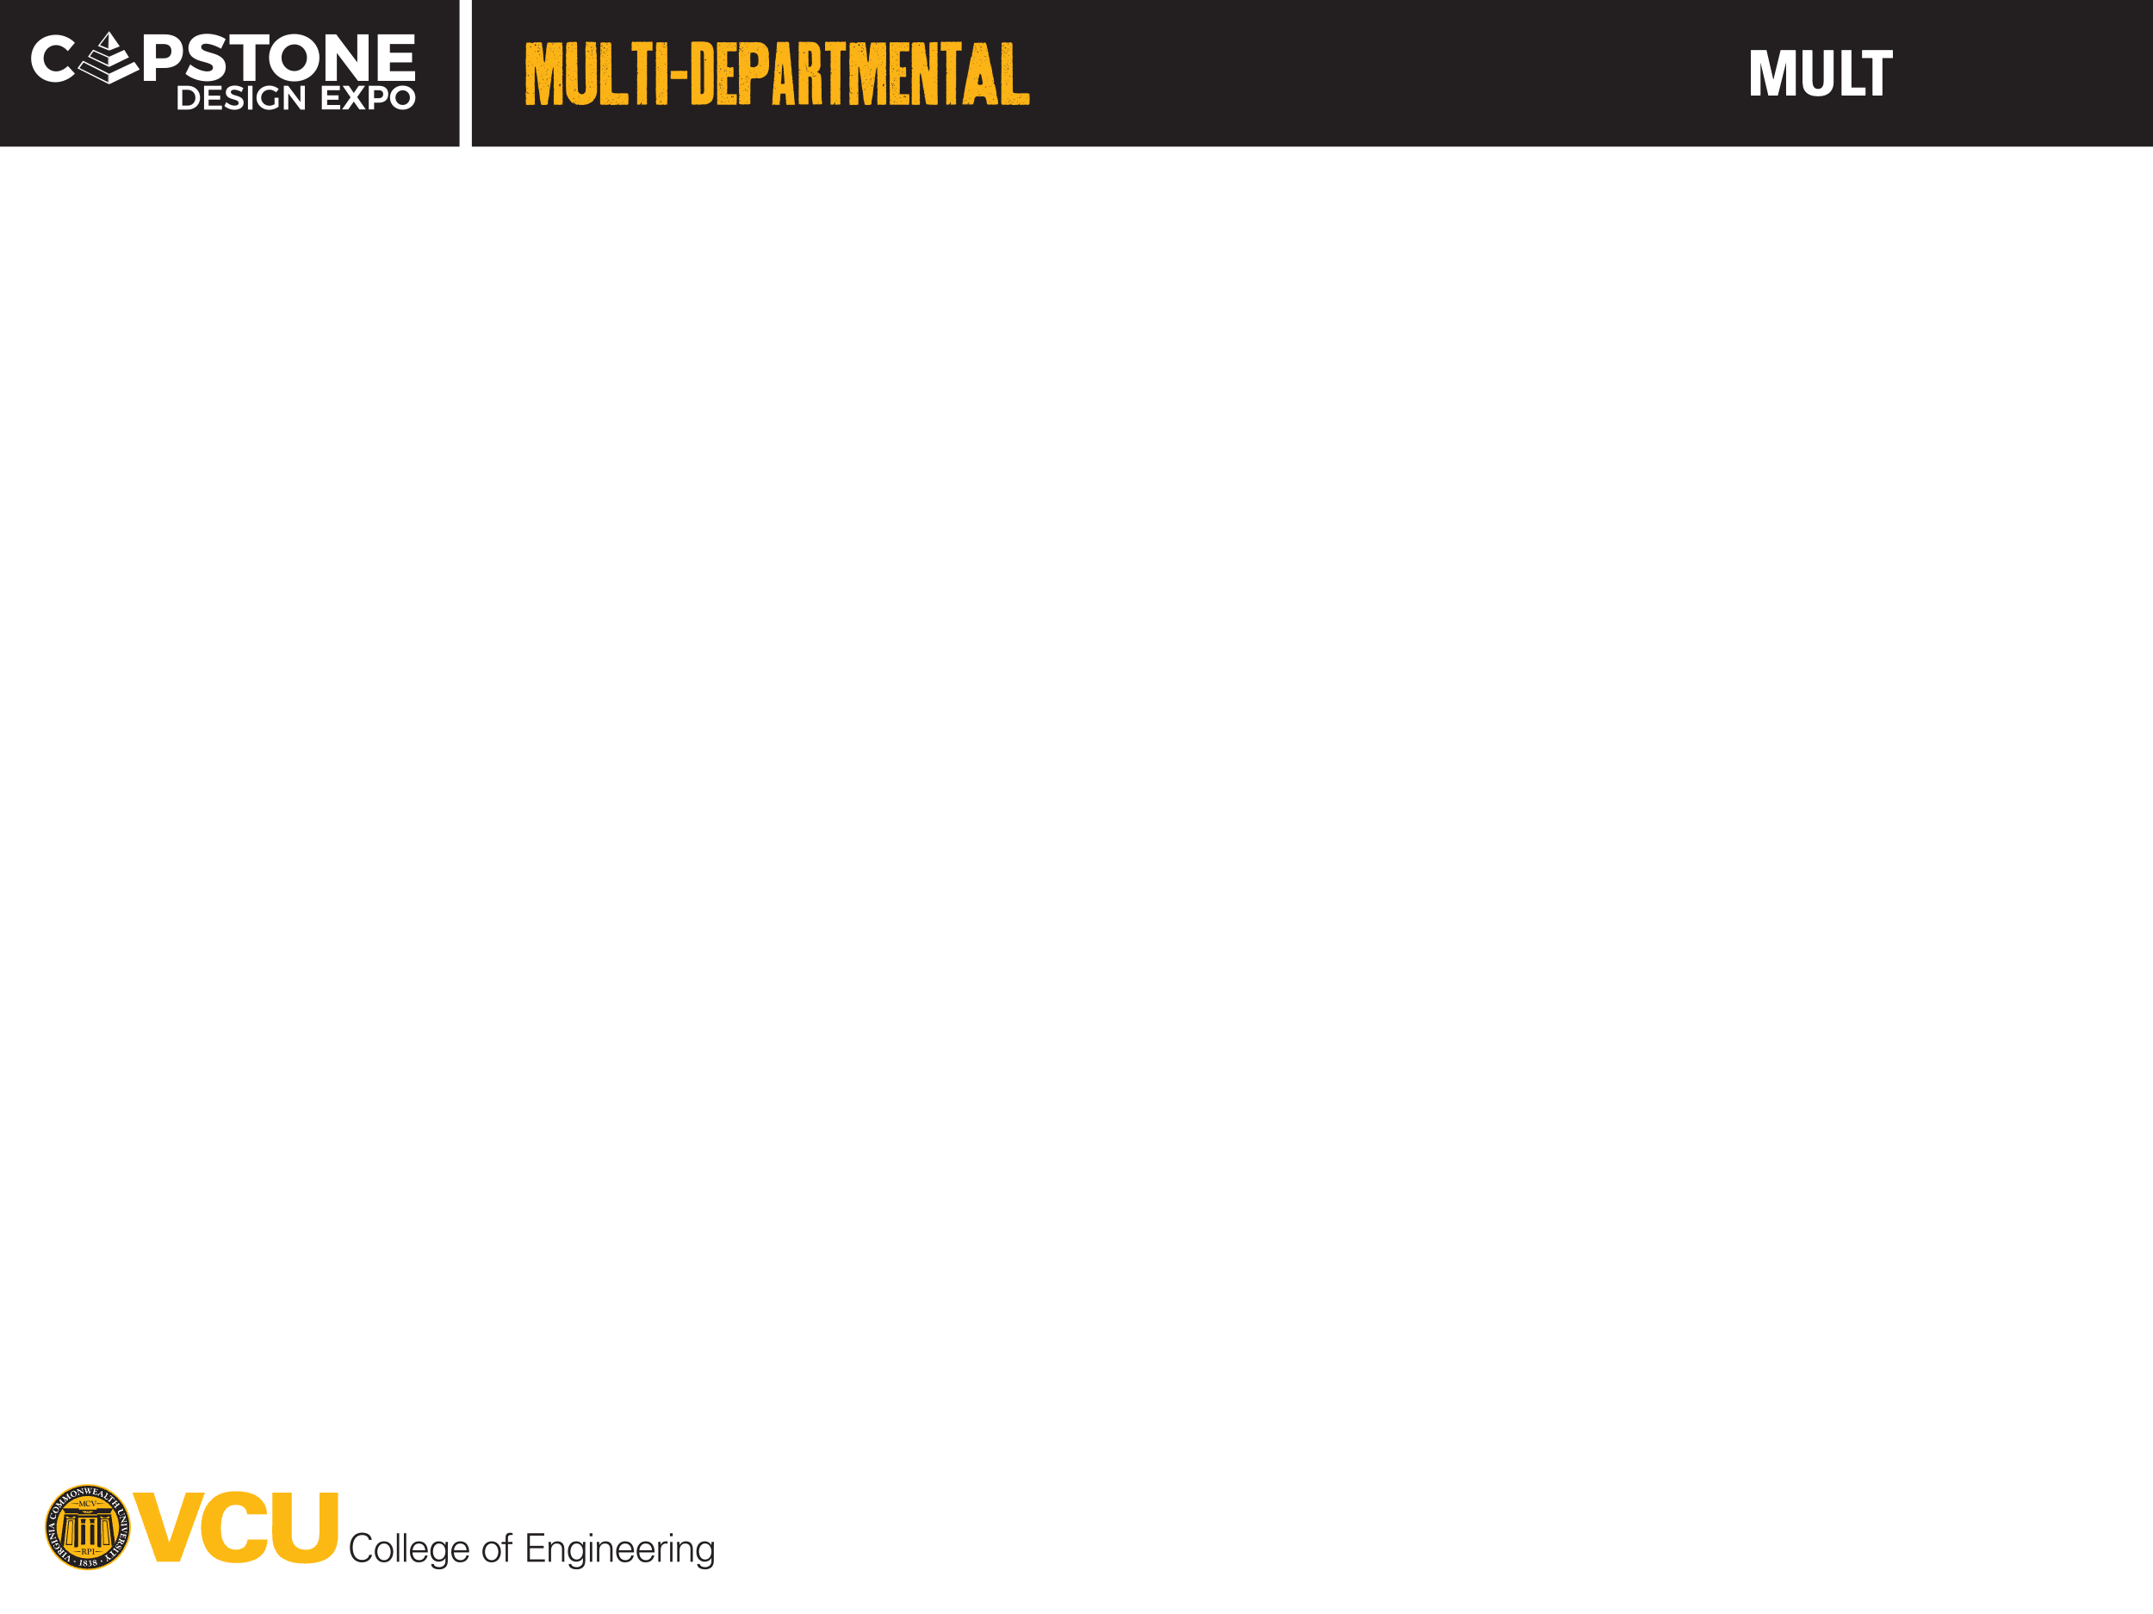
26-101

Slide 8
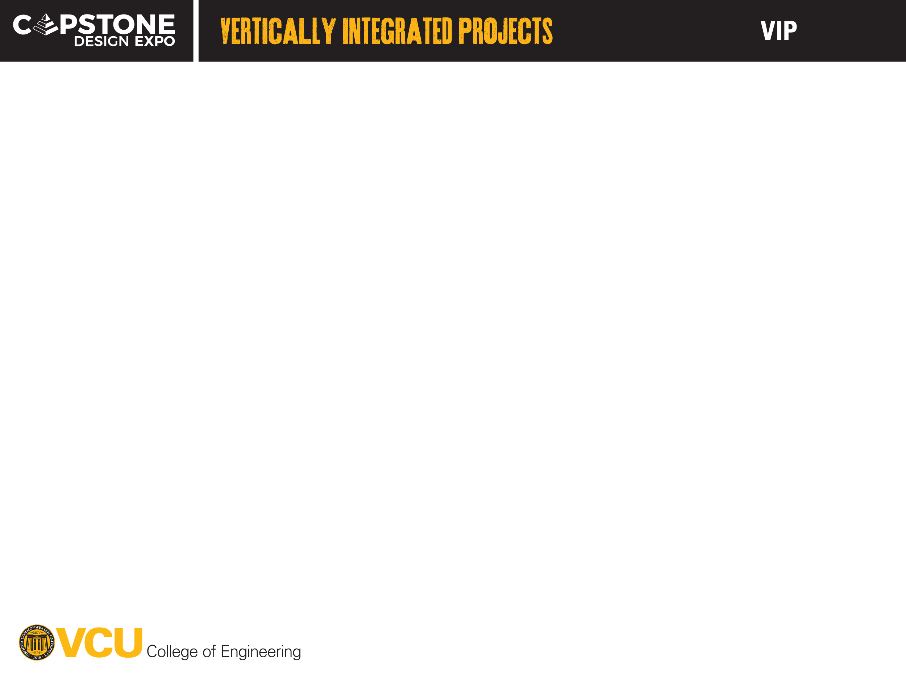
26-101

